Slide 1
Learning Outside the Classroom
Grosvenor Hall
Ashford, Kent
8th-12th July 2019

Slide 2
Welcome
Phones to silent. Presentation is on the school website.
Sign in.

Slide 3
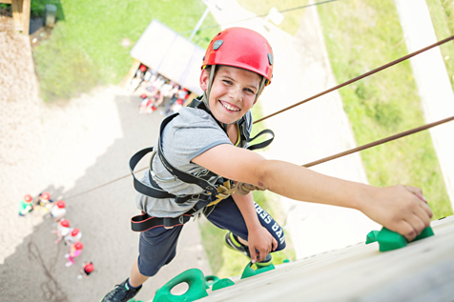
Where?
Kingswood - Grosvenor Hall, Kennington, Ashford, TN25 4AJ
49 miles. About an hour from Grays.

Slide 4
St Thomas’ staff
Miss Crofton
Mrs Crofton (medical)
Miss Barnett
Miss Barry
Mrs Sharp
Mrs Cook
Mrs Roskilly
Mrs Baker
Mr Keiller

Slide 5
Typical day
 | 9.30-10.40 | 10.50-12.00 | 12.05-13.15 | 13.15-14.25 | 14.30-15.40 | 15.50-17.00 | 17.05-18.15 | 18.15-19.25 | 19.45-21.00
Mon |  |  | L |  | Arrival and tour |  | D | Aerial runway | Scrap heap challenge
Tue | Aeroball | Fencing | U | Free time | Climb | 3G swing | I | Nightline | Campfire
Wed | Volleyball | Shelter | N | Free time | Swim | Archery | NN | Crate stack | Olympics
Thur | Fire lighting | Abseiling | C | Free time | Problem solving | Team challenge | E | Jacob’s ladder | Quiz
Fri | Field games | Outdoor laser | H |  |  |  | R

Slide 6
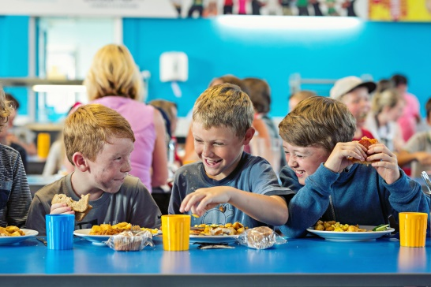
Typical menu
Breakfast – cereals, toast, fruit, yoghurt
Sausage, bacon, scrambled egg
Lunch –, Jacket potato, baguette, wrap, soup, pasta, salad, sausage roll, pasty
Dinner – pie, sausage, burger, hot dog, BBQ chicken, pork loin, lasagne, chicken ratatouille, garlic bread.
Brownie, doughnut, ice-cream, fruit crumble.
Vegetarian option every meal.

Slide 7
Clothes – preferably not new or expensive.
Socks and underwear, night clothes (slippers, indoor shoes)
Trousers (not jeans) and Shorts
Short sleeved t-shirts and long sleeved t-shirts
Jumper/fleece/sweatshirts
Waterproof jacket Trainers/shoes (3pairs)
Wellies or sturdy shoes
Swimming kit and towel
Plastic bag for dirty clothes

Slide 8
Toiletries
Toothbrush/toothpaste
Sponge or flannel
Soap or shower gel
Shampoo and conditioner
Towel for shower/wash
Hair ties (important during activities/meals)
Sun cream

Slide 9
Other kit
Packed lunch on Monday (no box – disposable)
Water bottle in a draw string bag to use during activities.
Cap/hat
Sunglasses (optional) Disposable camera
Book to read/cards to play/magazine
Paper/pens/addressed envelope to write home.
Sweets (not in rooms) and £10 spending money.

Slide 10
Not allowed
No phones or any other electronic items.
If parents need to contact a child in an emergency: school office or 01603 859106
If we need to contact parents I will have all phone numbers with me.

Slide 11
Accommodation
Rooms with 2-8 children. Children have chosen their friends, they will be with at least one friend in their room.
Please let Miss Crofton know if there are any children you do NOT want your child to share with.
Adults rooms close by.
There will be different groups during activities.

Slide 12
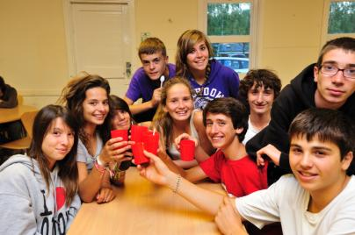
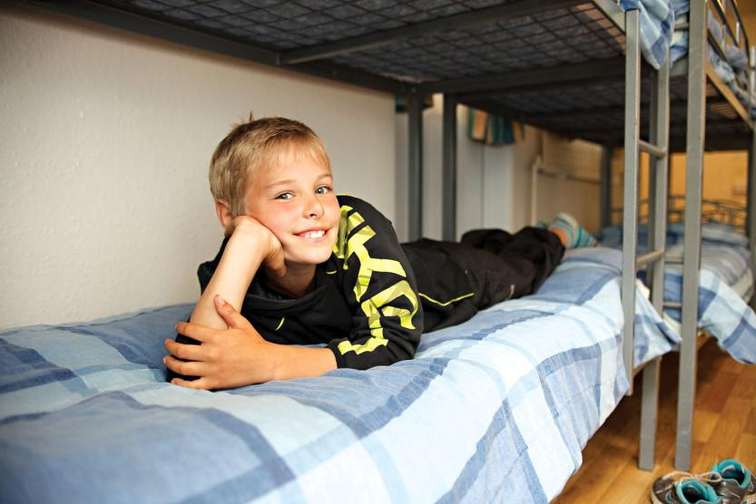
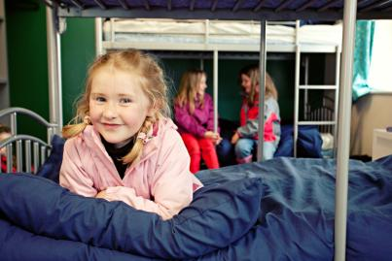
Bedtime routine
Plenty of sleep is required to recharge the batteries, so lights are usually turned out by 10.00pm.

Slide 13
Before 8th July
Pay any outstanding money.
Fill in medical form with up to date phone numbers and details of medication. Hand in by Wednesday 26th June please.
Involve the children in packing so that they know what they have and can pack independently when we return.

Slide 14
On Monday 8th July
Arrive at school between 9:30 and 10:00.
Parents to hand in medication to Mrs Crofton and inform of any instructions.
Children take lunch (disposable) and day bag on to the coach (to be eaten at the centre).
We will depart at 10:30.

Slide 15
While we are away…
We’ll do our best to update the year 6 web page.
Write to the children if you wish.
If they’d like to write to you – SAE or postcard would be helpful.
We’ll be back around 14:45 on Friday 12th July.

