Slide 1
Learning Outside the Classroom
Grosvenor Hall
Ashford, Kent
9th – 13th July 2018

Slide 2
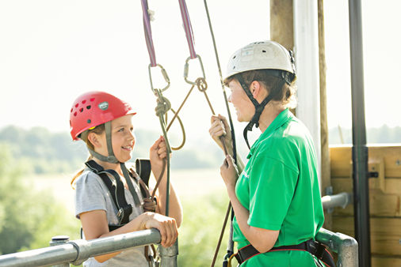
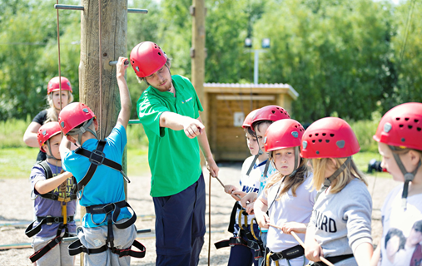
Welcome
Phones to silent.
Sign in.

Slide 3
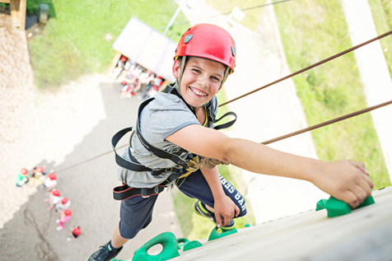
Where?
Kingswood - Grosvenor Hall,
Kennington,
Ashford,
TN25 4AJ
49 miles. About an hour from Grays.

Slide 4
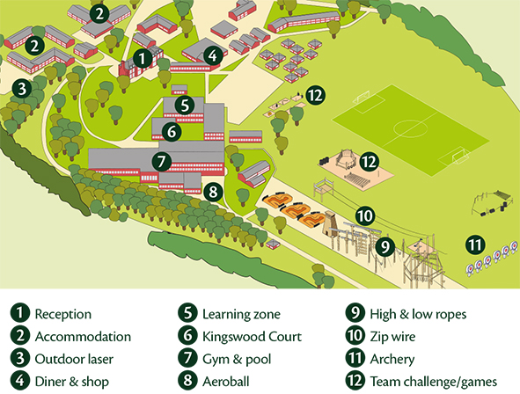
Your centre – Grosvenor Hall
Grosvenor Hall is a complete indoor and outdoor education centre featuring some of the best facilities of its kind in Europe. Set in the grounds of a former manor house in Ashford, Kent the site is a mix of historical buildings and state of the art adenture attractions.

Slide 5
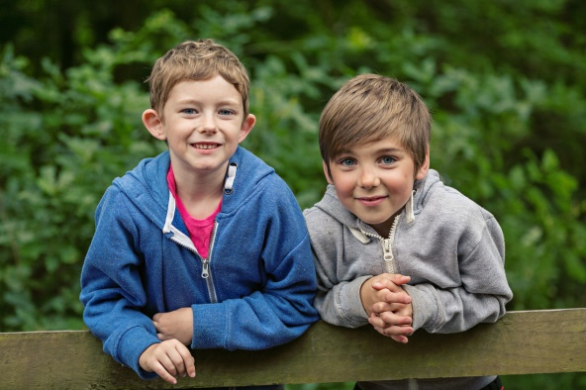
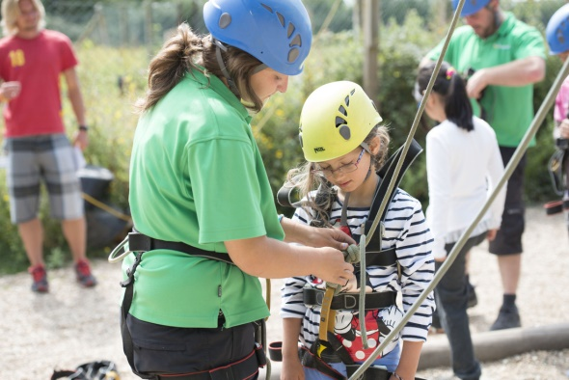
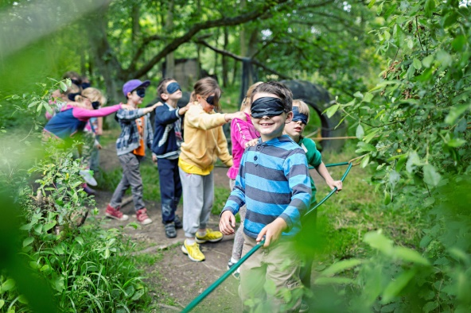

Introduction to Kingswood
We support teachers in bringing learning to life and with 30 years’ experience, we know what works and we are proud to deliver immersive learning at it’s very best.
• Working with 3,500 schools per year and 130,000 students, we are a leading trusted provider of residential trips
We aim to instil self confidence and a sense of achievement through a positive experience which is educational and enjoyable, challenging and rewarding
We know what we are doing!
  Founding members of the British Activities Providers Association (BAPA)
  We hold a ‘Learning Outside the Classroom’ quality badge and have full accreditation with all relevant agencies

Slide 6
Safety
Consideration for our visitors' safety runs through everything we do. Our centres are regularly inspected as part of our internal health and safety audit programme, and all of our team, from the CEO through to our teams on centre are always on the look-out for opportunities to improve what we do.
We also work closely with outside experts in the fields of activity provision, facility maintenance and health and safety management to ensure we remain at the forefront of accepted good practice.

Slide 7
Safety
All of our activity and learning programmes are operated in accordance with strict operating standards that define the minimum requirements for staff qualifications, supervision arrangements, equipment, facilities and appropriate clothing.
Individual activities follow a defined session plan and all instructors are regularly observed to ensure they are complying with our safety standards and delivering a quality experience to our visitors.

Slide 8
Instructors
All staff complete a comprehensive induction programme that includes NSPCC Child Protection training and Health & Safety qualifications as well as practical training in the fundamental skills of teaching and coaching young people. Following this induction, staff are trained in each of our activities and educational modules by experts in each of these fields.
Some of the activities, such as archery, fencing and lifeguarding, will require our staff to pass National Governing Body awards. Others, such as climbing, abseiling, zipwire and high ropes, require staff to complete in-house training with an independent external assessment.

Slide 9
St Thomas’ staff
Miss Crofton
Mrs Crofton (medical)
Miss Webb
Miss Barnett
Miss Doyle
Miss Barry
Mrs Sharp
Mrs Cook
Mrs Hudson
Mr Wojcik

Slide 10
Typical day
 | 9.30-10.40 | 10.50-12.00 | 12.05-13.15 | 13.15-14.25 | 14.30-15.40 | 15.50-17.00 | 17.05-18.15 | 18.15-19.25 | 19.45-21.00
Mon |  |  | L |  | Arrival and tour |  | D | Aerial runway | Scrap heap challenge
Tue | Aeroball | Fencing | U | Free time | Climb | 3G swing | I | Nightline | Campfire
Wed | Volleyball | Shelter | N | Free time | Swim | Archery | NN | Crate stack | Olympics
Thur | Fire lighting | Abseiling | C | Free time | Problem solving | Team challenge | E | Jacob’s ladder | Quiz
Fri | Field games | Outdoor laser | H |  |  |  | R

Slide 11
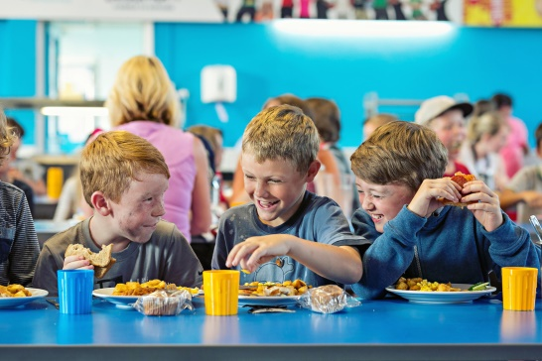
Typical menu
Breakfast – cereals, porridge, toast, fruit, yoghurt, Full English, pancakes, pastries, porridge.
Lunch – jacket potato, baguette, pasta, mac n cheese, salad, sausage roll, burger, taco.
Dinner – lasagne, curry, roast dinner, bolognaise, pork noodles, hot dog, meatballs.
Vegetarian option every meal. Varied dessert.

Slide 12
Clothes – preferably not new or expensive.
Socks and underwear, night clothes (slippers)
Trousers (not jeans) and Shorts
Short sleeved t-shirts and long sleeved t-shirts
Jumper/fleece/sweatshirts
Waterproof jacket Trainers/shoes (3pairs)
Wellies or sturdy shoes
Swimming kit and towel
Plastic bag for dirty clothes

Slide 13
Toiletries
Toothbrush/toothpaste
Sponge or flannel
Soap or shower gel
Shampoo and conditioner
Towel
Hair ties (important during activities/meals)
Sun cream

Slide 14
Other kit
Packed lunch on Monday (no box – disposable)
Water bottle in a draw string bag to use during activities.
Cap/hat
Sunglasses (optional) Disposable camera
Book to read/cards to play/magazine
Paper/pens/addressed envelope to write home.
Sweets (not in rooms) and £10 spending money.

Slide 15
Not allowed
No phones or any other electronic items.
If parents need to contact a child in an emergency: school office or 01603 859106
If we need to contact parents I will have all phone numbers with me.

Slide 16
Accommodation
Rooms with 2-8 children. Children have chosen their friends, they will be with at least one friend in their room.
Please let Miss Crofton know if there are any children you do NOT want your child to share with.
Adults rooms close by.
There will be different groups during activities.

Slide 17
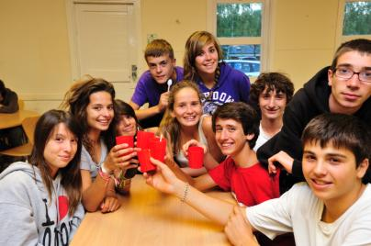
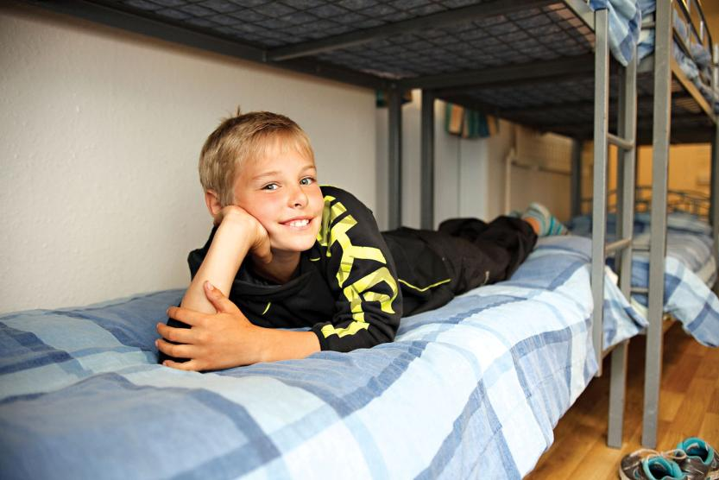
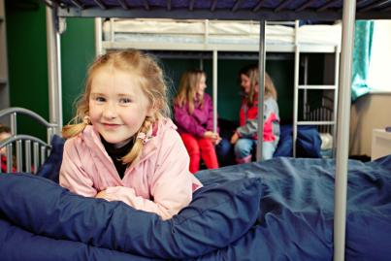
Bedtime routine
To finish off each day, hot chocolate is served on request before students return to their dorms. Plenty of sleep is required to recharge the batteries, so lights are usually turned out by 10.00pm.

Slide 18
Before 9th July
Pay any outstanding money.
Fill in medical form with up to date phone numbers and details of medication. Hand in by Monday 2nd July please.
Involve the children in packing so that they know what they have and can pack independently when we return.

Slide 19
On Monday 9th July
Arrive at school between 9:30 and 10:00.
Parents to hand in medication to Mrs Crofton and inform of any instructions.
Children take lunch and day bag on to the coach (to be eaten at the centre).
We will depart at 10:30.

Slide 20
While we are away…
We’ll do our best to update the year 6 web page.
Write to the children if you wish.
We’ll be back around 14:45 on Friday 13th July.

