Slide 1
Learning Outside the Classroom
Grosvenor Hall
Ashford, Kent
9th – 13th July 2018

Slide 2
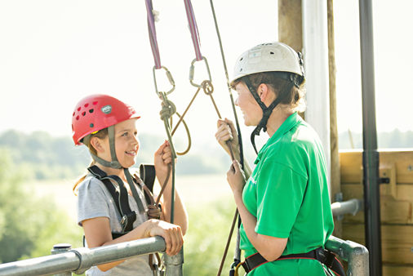
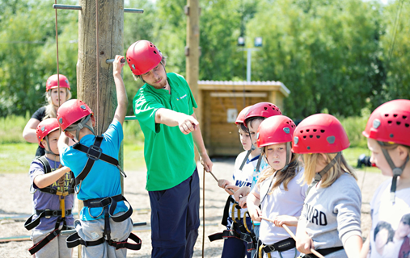
Welcome
Phones to silent.
Sign in.

Slide 3
Why?
As one of the leading providers of residential trips, we support teachers in bringing learning to life. As holders of the ‘Learning Outside the Classroom’ Quality Badge, we aim to instil self-confidence and a sense of achievement, through a positive experience which is educational, enjoyable, challenging and rewarding.

Slide 4
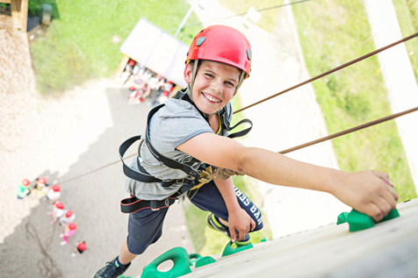
Where?
Kingswood - Grosvenor Hall,
Kennington,
Ashford,
TN25 4AJ
49 miles. About an hour from Grays.

Slide 5
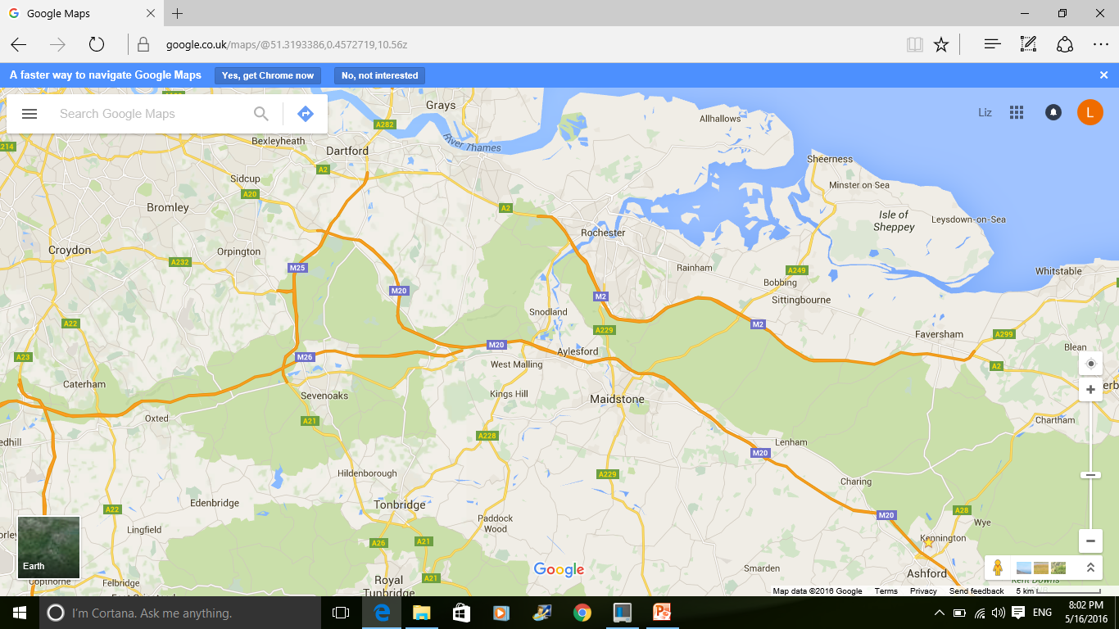
Map

Slide 6
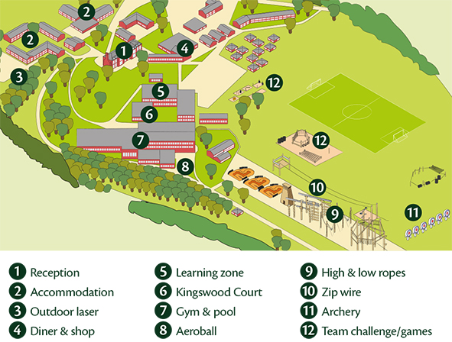
Your centre – Grosvenor Hall
Grosvenor Hall is a complete indoor and outdoor education centre featuring some of the best facilities of its kind in Europe. Set in the grounds of a former manor house in Ashford, Kent the site is a mix of historical buildings and state of the art adenture attractions.

Slide 7
With?
Kingswood provide educationally rich activity centre breaks for schools and groups. We are experts in out of the classroom learning - it is our 30 years of experience listening to and meeting teachers’ needs, combined with our ability to deliver leading educational programmes which meet curriculum standards and teachers’ objectives which make us an expert provider, welcoming schools back year after year.

Slide 8
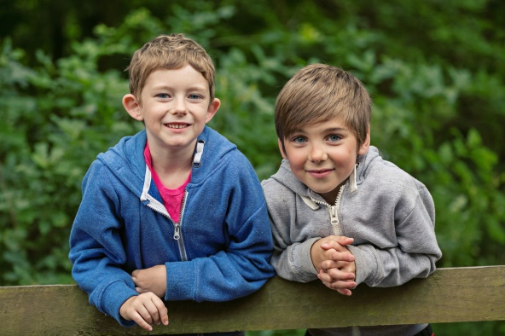
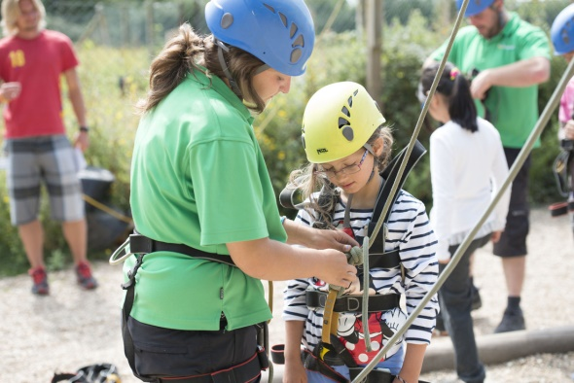
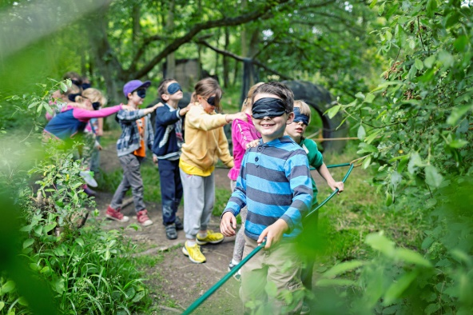

Introduction to Kingswood
We support teachers in bringing learning to life and with 30 years’ experience, we know what works and we are proud to deliver immersive learning at it’s very best.
• Working with 3,500 schools per year and 130,000 students, we are a leading trusted provider of residential trips
We aim to instil self confidence and a sense of achievement through a positive experience which is educational and enjoyable, challenging and rewarding
We know what we are doing!
  Founding members of the British Activities Providers Association (BAPA)
  We hold a ‘Learning Outside the Classroom’ quality badge and have full accreditation with all relevant agencies

Slide 9
Safety
Consideration for our visitors' safety runs through everything we do. Our centres are regularly inspected as part of our internal health and safety audit programme, and all of our team, from the CEO through to our teams on centre are always on the look-out for opportunities to improve what we do.
We also work closely with outside experts in the fields of activity provision, facility maintenance and health and safety management to ensure we remain at the forefront of accepted good practice.

Slide 10
Safety
All of our activity and learning programmes are operated in accordance with strict operating standards that define the minimum requirements for staff qualifications, supervision arrangements, equipment, facilities and appropriate clothing.
Individual activities follow a defined session plan and all instructors are regularly observed to ensure they are complying with our safety standards and delivering a quality experience to our visitors.

Slide 11
External standards
Some higher risk activities, such as watersports, require the provider to prove they meet additional safety standards. The Adventurous Activities Licensing Authority (AALA) issues licences to activity providers to operate activities that have been externally inspected to confirm they are safe, well organised and risk is being managed. Details of the licenses Kingswood holds can be found on the website.
Kingswood is a founder member of BAPA, the British Activity Providers Association. BAPA seeks to safeguard standards and be a voice to champion the benefits of activities for young people. Member centres must abide by the BAPA ‘Code of Practice’ and are committed to high standards of health and safety. This commitment is tested during inspections by independent BAPA inspectors. Further details on BAPAs ‘Code of Practice’ and other information can be found at www.thebapa.org.uk.
Learning Outside the Classroom (LOtC) Quality Badge

Slide 12
Instructors
All staff complete a comprehensive induction programme that includes NSPCC Child Protection training and Health & Safety qualifications as well as practical training in the fundamental skills of teaching and coaching young people. Following this induction, staff are trained in each of our activities and educational modules by experts in each of these fields.
Some of the activities, such as archery, fencing and lifeguarding, will require our staff to pass National Governing Body awards. Others, such as climbing, abseiling, zipwire and high ropes, require staff to complete in-house training with an independent external assessment.

Slide 13
Typical day
 | 9.30-10.40 | 10.50-12.00 | 12.05-13.15 | 13.15-14.25 | 14.30-15.40 | 15.50-17.00 | 17.05-18.15 | 18.15-19.25 | 19.45-21.00
Mon |  |  |  | L | Arrival and tour |  | Aerial runway | D | Scrap heap challenge
Tue | Aeroball | Fencing | Free time | U | 3G swing | Outdoor climb | Nightline | I | Olympic games
Wed | Problem solving | Bushcraft shelter | Free time | N | Volleyball | Swimming | Archery | NN | Campfire
Thur | Crate stack | Field games | Free time | CH | Abseiling | Fire lighters | Team challenge | ER | Quiz
Fri | Jacob’s ladder | Outdoor laser | Lunch | Leave for home

Slide 14
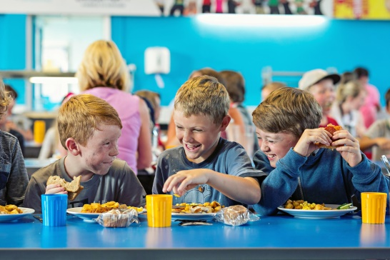
Typical menu
Breakfast – cereals, porridge, toast
Full English, pancakes, pastries (different days)
Lunch – roast chicken, stir fry, pizza, burger, fish-fingers, risotto, bolognaise (different days)
Dinner – Sweet and sour pork, chicken and leek pie, feta and spinach parcels, sausages, chicken tikka masala (different days)
Jacket potato and salad available everyday. Vegetarian option every meal.

Slide 15
Clothes – preferably not new or expensive.
Socks and underwear, night clothes (slippers)
Trousers (not jeans) and Shorts
Short sleeved t-shirts and long sleeved t-shirts
Jumper/fleece/sweatshirts
Waterproof jacket Trainers/shoes (3pairs)
Swimming kit and towel
Towel for showering.

Slide 16
Toiletries
Toothbrush/toothpaste
Sponge or flannel
Soap or shower gel
Shampoo and conditioner
Hair ties (important during activities/meals)
Sun cream

Slide 17
Other kit
Packed lunch on Monday
Water bottle in a draw string bag to use during activities.
Cap/hat
Sunglasses (optional) Disposable camera
Book to read/cards to play
Paper/pens/addressed envelope to write home.
Sweets (not in rooms) and £10 spending money.

Slide 18
Accommodation
Rooms with 2-8 children. Children have chosen their friends, they will be with at least one friend in their room.
Please let Miss Crofton know if there are any children you do NOT want your child to share with.
Adults rooms close by.
There will be different groups during activities.

Slide 19
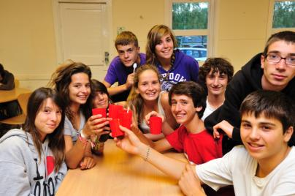
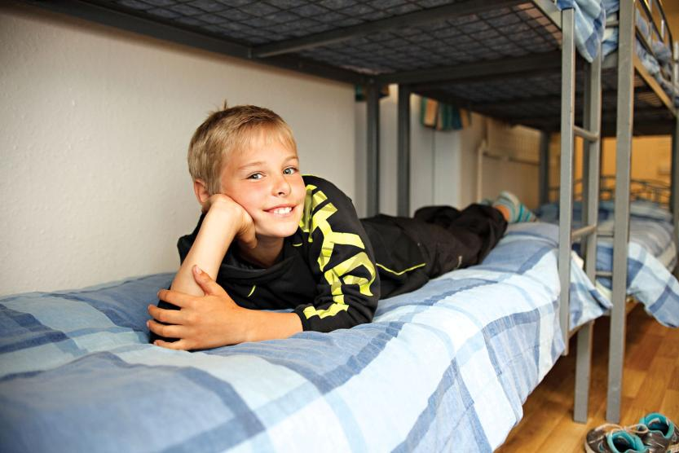
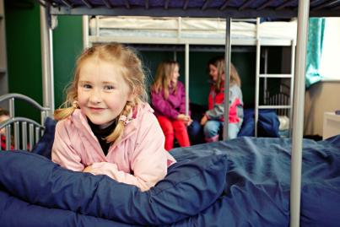
Bedtime routine
To finish off each day, hot chocolate is served on request before students return to their dorms. Plenty of sleep is required to recharge the batteries, so lights are usually turned out by 10.00pm.

